Slide 1
moolio
by: phu & valli

Slide 2

What is moolio?
moolio
a movie for every mood
browse and find movies based on you mood! an iOS app that changes the way you find movies - just for you!

Slide 3
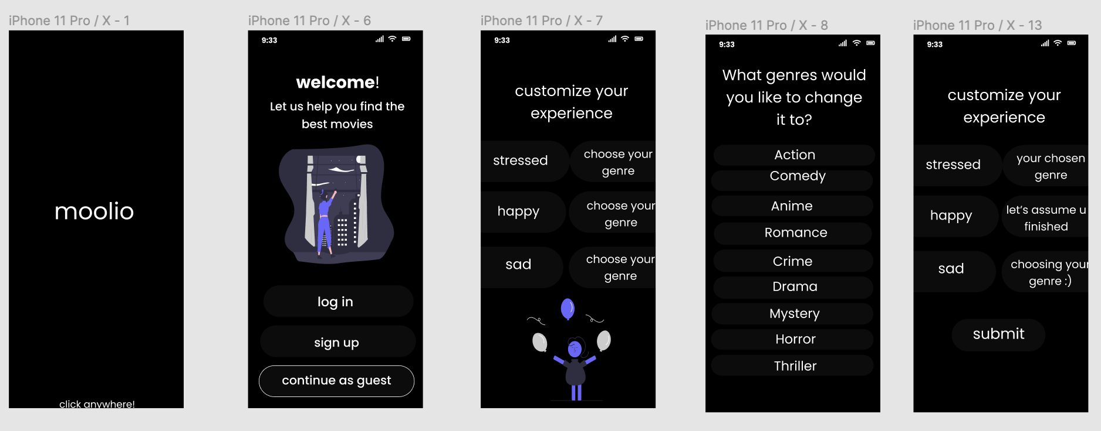
Mock Up

Slide 4
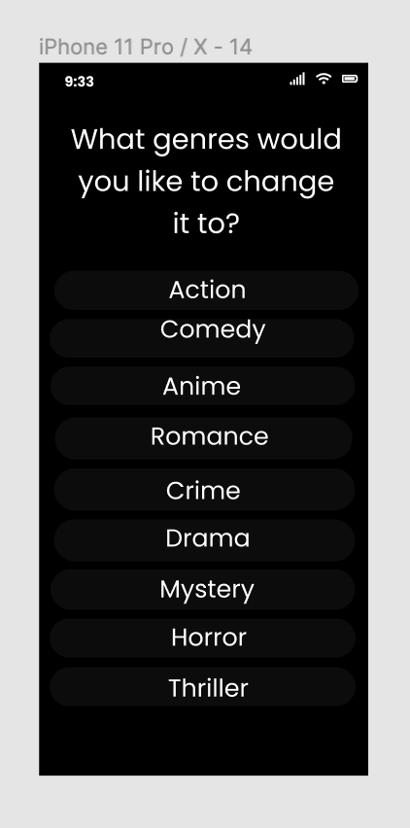
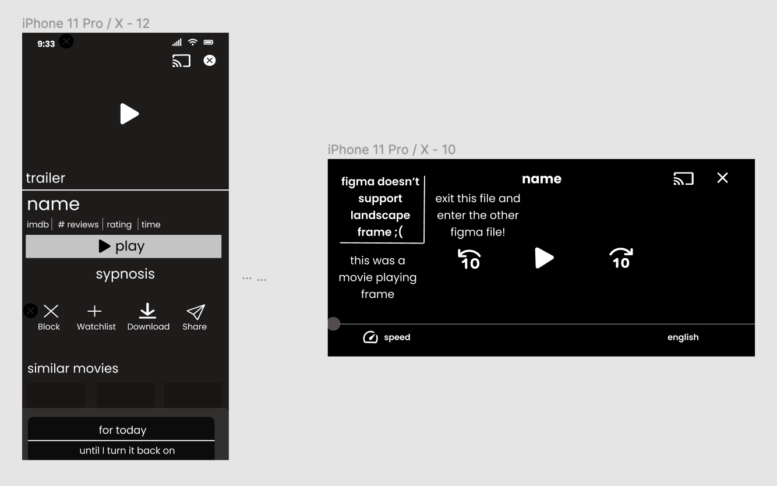
Mock Up

Slide 5
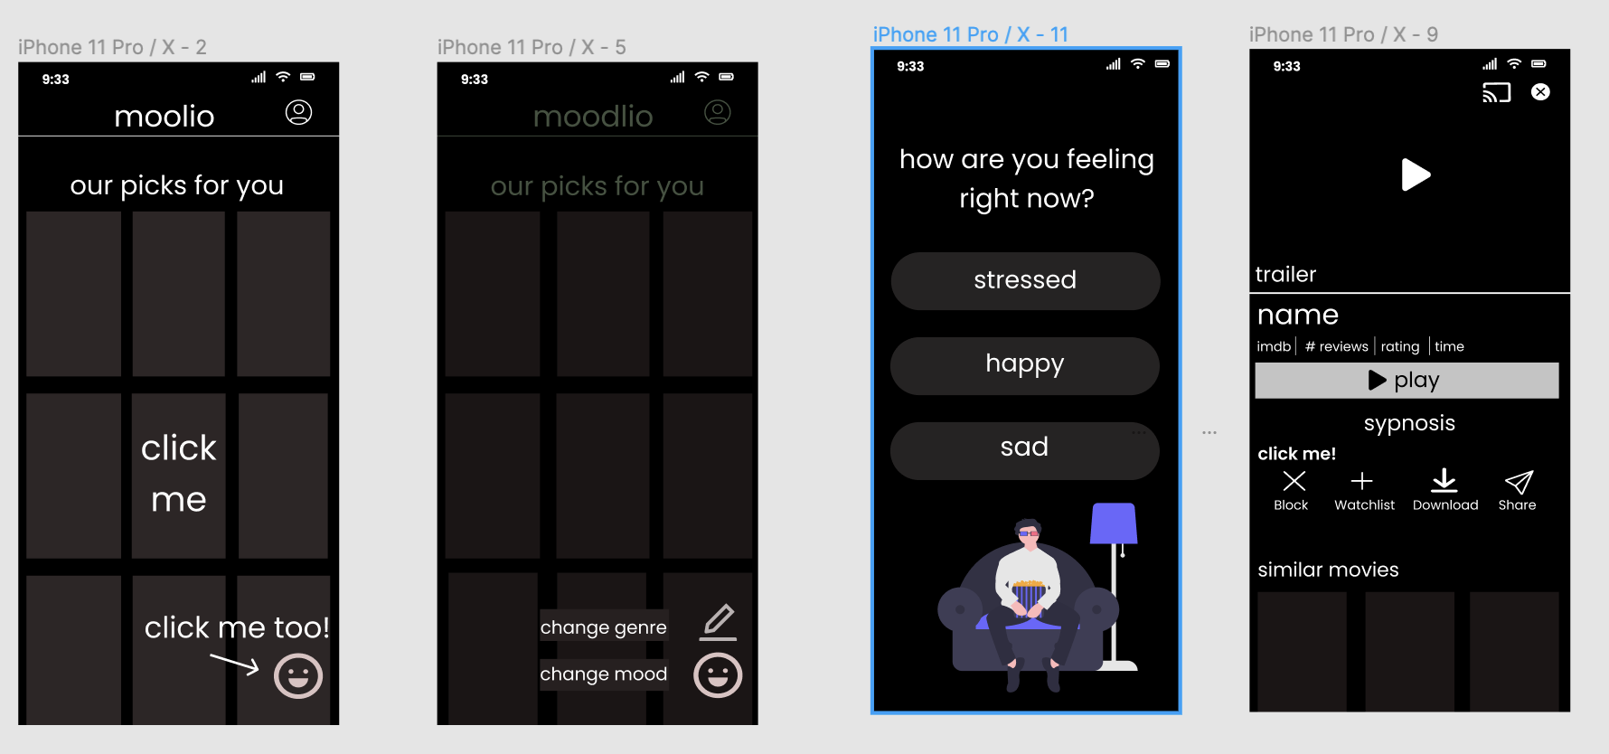
Mock Up

Slide 6
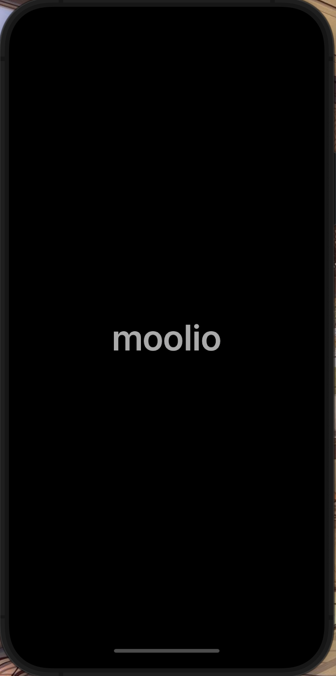

Key Features

Slide 7
Key Features
Log in/Sign Up
Guest Feature
Genres By Mood
Customization
create an account to save their preferences
use the app anonymously if you choose
view movie options based on a given mood
select which genres you prefer for each mood

Slide 8
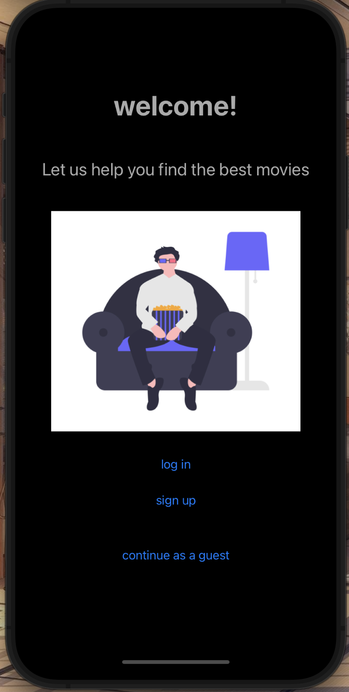
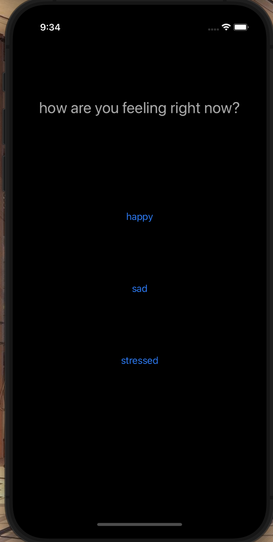
Notes:
guest

Slide 9
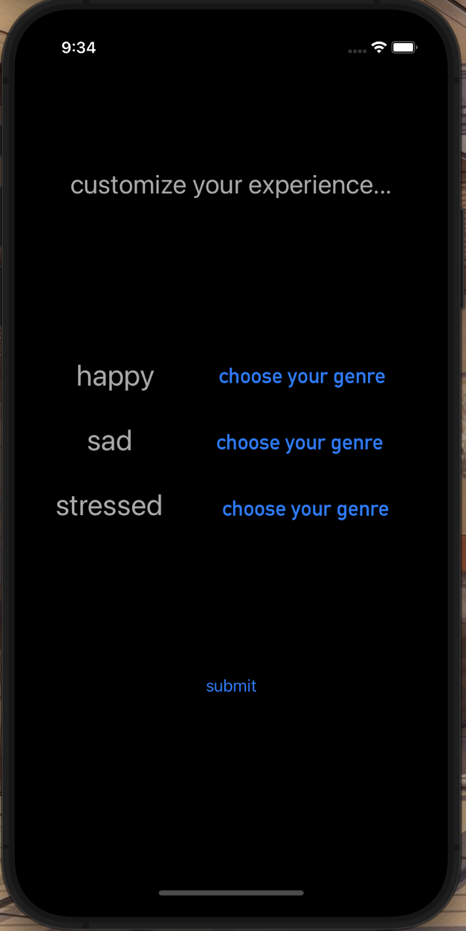
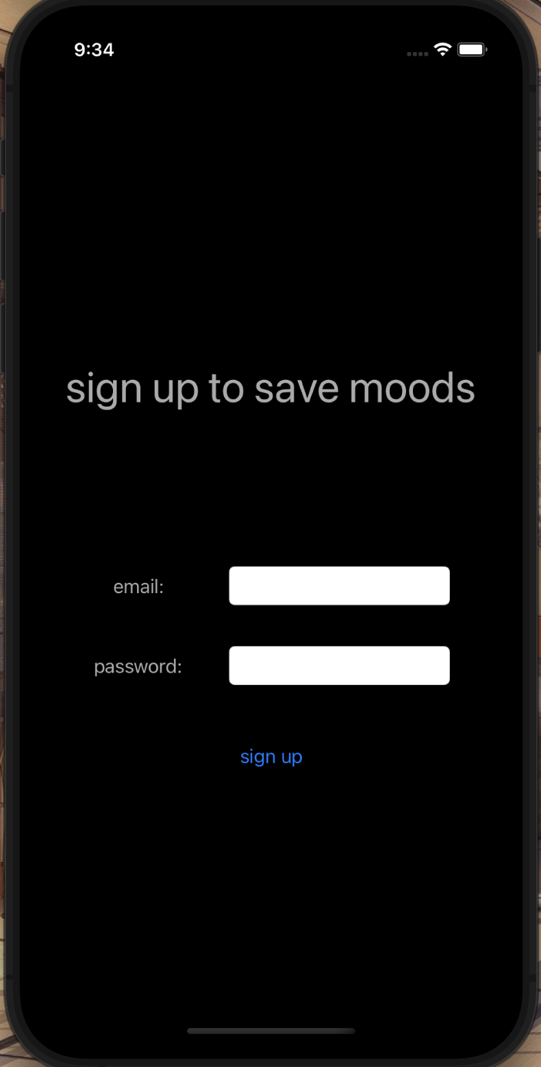
Notes:
Sign up

Slide 10
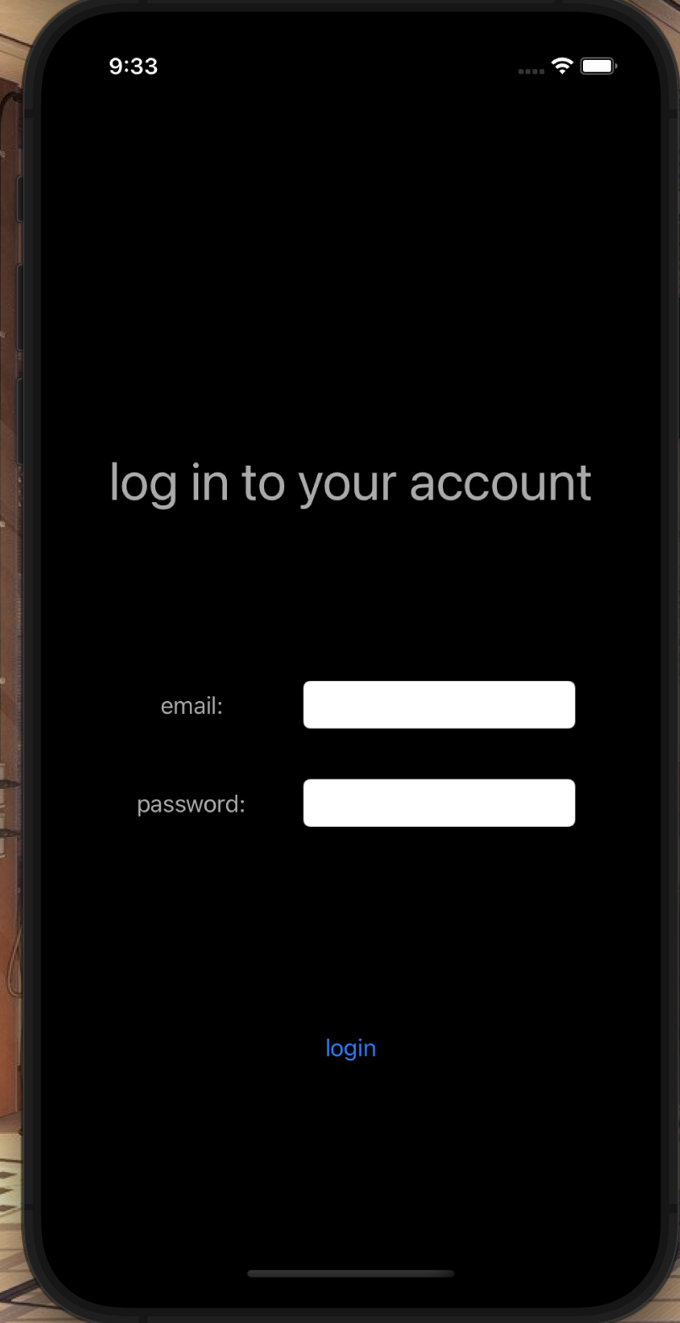
Notes:
login

Slide 11
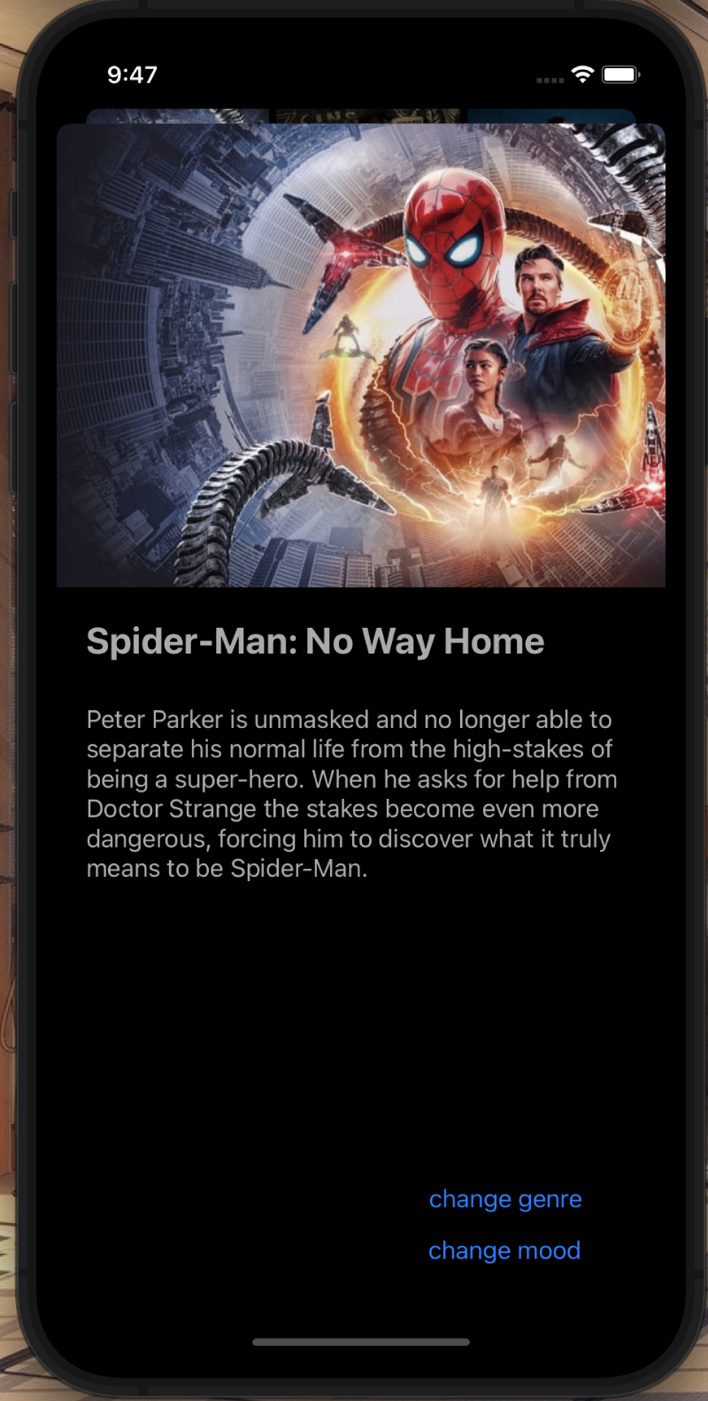
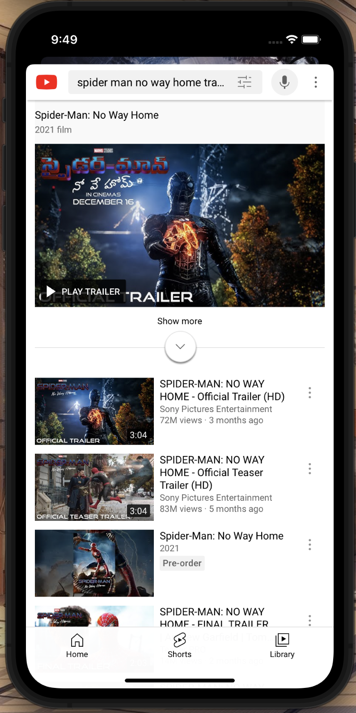
Notes:
Main screens- genre goes back to customization, mood goes to select mood

Slide 12
Future Plans
Features | Appearance | Community
Add more features for accuracy in movie selection | Simplify interface to make using the app easier | Create a community that can share recommendations to others

Slide 13
Thank You

